Slide 1
Developing and evaluating an anomaly detection system

Slide 2
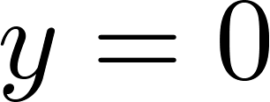
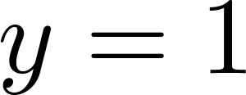
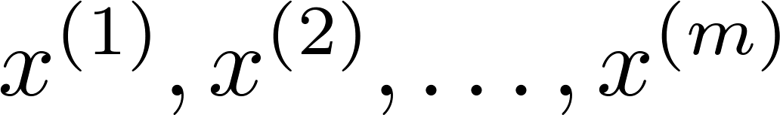
The importance of real-number evaluation
When developing a learning algorithm (choosing features, etc.), making decisions is much easier if we have a way of evaluating our learning algorithm.
Assume we have some labeled data, of anomalous and non-anomalous examples. ( if normal, if anomalous).
Training set: (assume normal examples/not anomalous)
Cross validation set:
Test set:
Notes:
Replace as previous; change spacing to fill page

Slide 3
Aircraft engines motivating example
In practical, it’s about 2-50
10000 good (normal) engines
20 flawed engines (anomalous)
Training set: 6000 good engines
CV: 2000 good engines ( ), 10 anomalous ( )
Test: 2000 good engines ( ), 10 anomalous ( )
Alternative:
Training set: 6000 good engines
CV: 4000 good engines ( ), 10 anomalous ( )
Test: 4000 good engines ( ), 10 anomalous ( )

Slide 4
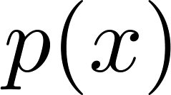
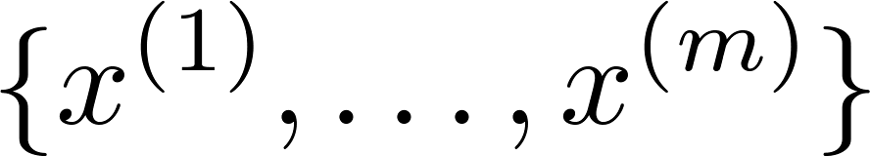

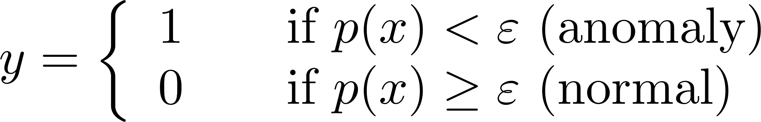

Algorithm evaluation
Fit model on training set
On a cross validation/test example , predict
Possible evaluation metrics:
- True positive, false positive, false negative, true negative
- Precision/Recall
- F₁-score
Can also use cross validation set to choose parameter

Slide 5
Anomaly detection vs. supervised learning

Slide 6


Anomaly detection
vs.
Supervised learning
Very small number of positive examples ( ). (0-20 is common).
Large number of negative ( ) examples.
Many different “types” of anomalies. Hard for any algorithm to learn from positive examples what the anomalies look like; future anomalies may look nothing like any of the anomalous examples we’ve seen so far.
Large number of positive and negative examples.
Enough positive examples for algorithm to get a sense of what positive examples are like, future positive examples likely to be similar to ones in training set.
Notes:
Make points have 0 mean on x1 and x2

Slide 7
Anomaly detection
vs.
Supervised learning
Fraud detection
Manufacturing (e.g. aircraft engines)
Monitoring machines in a data center
Email spam classification
Weather prediction (sunny/rainy/etc).
Cancer classification
Notes:
Make points have 0 mean on x1 and x2

